Slide 1
Digital Design & Computer Arch.
Lecture 16b: Branch Prediction I
Prof. Onur Mutlu
ETH Zürich
Spring 2020
23 April 2020

Slide 2
Required Readings
This week
  Smith and Sohi, “The Microarchitecture of Superscalar Processors,” Proceedings of the IEEE, 1995
  H&H Chapters 7.8 and 7.9
  McFarling, “Combining Branch Predictors,” DEC WRL Technical Report, 1993.

Slide 3
Agenda for Today & Next Few Lectures
Single-cycle Microarchitectures
Multi-cycle and Microprogrammed Microarchitectures
Pipelining
Issues in Pipelining: Control & Data Dependence Handling, State Maintenance and Recovery, …
Out-of-Order Execution
Other Execution Paradigms

Slide 4
Approaches to (Instruction-Level) Concurrency
Pipelining
Out-of-order execution
Dataflow (at the ISA level)
Superscalar Execution
VLIW
Fine-Grained Multithreading
SIMD Processing (Vector and array processors, GPUs)
Decoupled Access Execute
Systolic Arrays

Slide 5
Control Dependence Handling

Slide 6
Control Dependence
Question: What should the fetch PC be in the next cycle?
Answer: The address of the next instruction
  All instructions are control dependent on previous ones. Why?
If the fetched instruction is a non-control-flow instruction:
  Next Fetch PC is the address of the next-sequential instruction
  Easy to determine if we know the size of the fetched instruction
If the instruction that is fetched is a control-flow instruction:
  How do we determine the next Fetch PC?
In fact, how do we even know whether or not the fetched instruction is a control-flow instruction?

Slide 7
Branch Types
Type | Direction at fetch time | Number of possible next fetch addresses? | When is next fetch address resolved?
Conditional | Unknown | 2 | Execution (register dependent)
Unconditional | Always taken | 1 | Decode (PC + offset)
Call | Always taken | 1 | Decode (PC + offset)
Return | Always taken | Many | Execution (register dependent)
Indirect | Always taken | Many | Execution (register dependent)
Different branch types can be handled differently

Slide 8
How to Handle Control Dependences
Critical to keep the pipeline full with correct sequence of dynamic instructions.
Potential solutions if the instruction is a control-flow instruction:
Stall the pipeline until we know the next fetch address
Guess the next fetch address (branch prediction)
Employ delayed branching (branch delay slot)
Do something else (fine-grained multithreading)
Eliminate control-flow instructions (predicated execution)
Fetch from both possible paths (if you know the addresses of both possible paths) (multipath execution)

Slide 9
Stall Fetch Until Next PC is Known: Good Idea?
t₀
t₀
t₀
t₀
t₀
t₀
t₀
t₁
t₁
t₁
t₁
t₁
t₁
t₁
t₂
t₂
t₂
t₂
t₂
t₂
t₂
t₃
t₃
t₃
t₃
t₃
t₃
t₃
t₄
t₄
t₄
t₄
t₄
t₄
t₄
t₅
t₅
t₅
t₅
t₅
t₅
t₅
Inst_{h}
Inst_{h}
Inst_{h}
Inst_{h}
Inst_{h}
Inst_{h}
Inst_{h}
IF
IF
IF
IF
IF
IF
IF
ID
ID
ID
ID
ID
ID
ALU
ALU
ALU
ALU
ALU
MEM
MEM
MEM
MEM
WB
WB
WB
Inst_{i}
Inst_{i}
Inst_{i}
Inst_{i}
Inst_{i}
Inst_{i}
Inst_{i}
IF
IF
IF
IF
IF
IF
IF
IF
IF
IF
IF
ID
ID
ID
ID
ALU
ALU
ALU
MEM
MEM
WB
Inst_{j}
Inst_{j}
Inst_{j}
Inst_{j}
Inst_{j}
Inst_{j}
Inst_{j}
IF
IF
IF
IF
IF
IF
IF
ID
ID
ALU
Inst_{k}
Inst_{k}
Inst_{k}
Inst_{k}
Inst_{k}
Inst_{k}
Inst_{k}
IF
IF
IF
Inst_{l}
Inst_{l}
Inst_{l}
Inst_{l}
Inst_{l}
Inst_{l}
Inst_{l}
This is the case with non-control-flow and unconditional br instructions!

Slide 10
The Branch Problem
Control flow instructions (branches) are frequent
  15-25% of all instructions
Problem: Next fetch address after a control-flow instruction is not determined after N cycles in a pipelined processor
  N cycles: (minimum) branch resolution latency
If we are fetching W instructions per cycle (i.e., if the pipeline is W wide)
  A branch misprediction leads to N x W wasted instruction slots

Slide 11
Importance of The Branch Problem
Assume N = 20 (20 pipe stages), W = 5 (5 wide fetch)
  Assume: 1 out of 5 instructions is a branch
  Assume: Each 5 instruction-block ends with a branch
How long does it take to fetch 500 instructions?
  100% accuracy
    100 cycles (all instructions fetched on the correct path)
    No wasted work; IPC = 500/100
  99% accuracy
    100 (correct path) + 20 * 1 (wrong path) = 120 cycles
    20% extra instructions fetched; IPC = 500/120
  90% accuracy
    100 (correct path) + 20 * 10 (wrong path) = 300 cycles
    200% extra instructions fetched; IPC = 500/300
  60% accuracy
    100 (correct path) + 20 * 40 (wrong path) = 900 cycles
    800% extra instructions fetched; IPC = 500/900

Slide 12
Branch Prediction

Slide 13
Branch Prediction: Guess the Next Instruction to Fetch
PC
??
0x0006
0x0007
0x0008
0x0005
0x0004
I-$
DEC
RF
WB
0x0001
LD R1, MEM[R0]
0x0002
ADD R2, R2, #1
D-$
Stall fetch
0x0003
BRZERO 0x0001
0x0004
ADD R3, R2, #1
12 cycles
0x0005
MUL R1, R2, R3
0x0006
LD R2, MEM[R2]
Branch prediction
0x0007
LD R0, MEM[R2]
8 cycles

Slide 14
Misprediction Penalty
PC
Flush!!
I-$
DEC
RF
WB
0x0001
LD R1, MEM[R0]
0x0007
0x0006
0x0005
0x0004
0x0003
0x0002
ADD R2, R2, #1
D-$
0x0003
BRZERO 0x0001
0x0004
ADD R3, R2, #1
0x0005
MUL R1, R2, R3
0x0006
LD R2, MEM[R2]
0x0007
LD R0, MEM[R2]

Slide 15
Simplest: Always Guess NextPC = PC + 4
Always predict the next sequential instruction is the next instruction to be executed
This is a form of next fetch address prediction (and branch prediction)
How can you make this more effective?
Idea: Maximize the chances that the next sequential instruction is the next instruction to be executed
  Software: Lay out the control flow graph such that the “likely next instruction” is on the not-taken path of a branch
    Profile guided code positioning → Pettis & Hansen, PLDI 1990.
  Hardware: ??? (how can you do this in hardware…)
    Cache traces of executed instructions → Trace cache
Notes:
Pettis and Hansen, Profile guided code positioning, PLDI 1990.
Trace caches…

Slide 16
Guessing NextPC = PC + 4
How else can you make this more effective?
Idea: Get rid of control flow instructions (or minimize their occurrence)
How?
  1. Get rid of unnecessary control flow instructions → combine predicates (predicate combining)
  2. Convert control dependences into data dependences → predicated execution

Slide 17
Branch Prediction: Always PC+4
t₀
t₀
t₀
t₁
t₁
t₁
t₂
t₂
t₂
t₃
t₃
t₃
t₄
t₄
t₄
t₅
t₅
t₅
Inst_{h}
Inst_{h}
Inst_{h}
IF_{PC}
IF_{PC}
IF_{PC}
ID
ID
ALU
ALU
MEM
Inst_{i}
Inst_{i}
Inst_{i}
IF_{PC+4}
IF_{PC+4}
ID
ID
ALU
Inst_{j}
Inst_{j}
Inst_{j}
IF_{PC+8}
IF_{PC+8}
ID
Inst_{k}
Inst_{k}
Inst_{k}
IF_{target}
Inst_{l}
Inst_{l}
Inst_{l}
Inst_{h} branch condition and target
evaluated in ALU
When a branch resolves
- branch target (Inst_{k}) is fetched
- all instructions fetched since
inst_{h} (so called “wrong-path”
instructions) must be flushed
Inst_{h} is a branch

Slide 18
Pipeline Flush on a Misprediction
t₀
t₁
t₂
t₃
t₄
t₅
Inst_{h}
IF_{PC}
ID
ALU
MEM
WB
Inst_{i}
IF_{PC+4}
ID
killed
Inst_{j}
IF_{PC+8}
killed
Inst_{k}
IF_{target}
ID
ALU
WB
Inst_{l}
IF
ID
ALU
IF
ID
IF
Inst_{h} is a branch

Slide 19
Performance Analysis
correct guess ⇒ no penalty ~86% of the time
incorrect guess ⇒ 2 bubbles
Assume
  no data dependency related stalls
  20% control flow instructions
  70% of control flow instructions are taken
  CPI = [ 1 + (0.20*0.7) * 2 ] =
  = [ 1 + 0.14 * 2 ] = 1.28
probability of
a wrong guess
penalty for
a wrong guess
Can we reduce either of the two penalty terms?

Slide 20
Reducing Branch Misprediction Penalty
Resolve branch condition and target address early
Is this a good idea?
  CPI = [ 1 + (0.2*0.7) * 1 ] = 1.14
[Based on original figure from P&H CO&D, COPYRIGHT 2004 Elsevier. ALL RIGHTS RESERVED.]

Slide 21
Branch Prediction (A Bit More Enhanced)
Idea: Predict the next fetch address (to be used in the next cycle)
Requires three things to be predicted at fetch stage:
  Whether the fetched instruction is a branch
  (Conditional) branch direction
  Branch target address (if taken)
Observation: Target address remains the same for a conditional direct branch across dynamic instances
  Idea: Store the target address from previous instance and access it with the PC
  Called Branch Target Buffer (BTB) or Branch Target Address Cache

Slide 22
Fetch Stage with BTB and Direction Prediction
Direction predictor (taken?)
taken?
PC + inst size
Next Fetch
Address
Program
Counter
hit?
Address of the
current branch
target address
Cache of Target Addresses (BTB: Branch Target Buffer)

Slide 23
More Sophisticated Branch Direction Prediction
Which direction earlier
branches went
Direction predictor (taken?)
taken?
Global branch
history
PC + inst size
Next Fetch
Address
XOR
Program
Counter
hit?
Address of the
current branch
target address
Cache of Target Addresses (BTB: Branch Target Buffer)

Slide 24
Three Things to Be Predicted
Requires three things to be predicted at fetch stage:
  1. Whether the fetched instruction is a branch
  2. (Conditional) branch direction
  3. Branch target address (if taken)
Third (3.) can be accomplished using a BTB
  Remember target address computed last time branch was executed
First (1.) can be accomplished using a BTB
  If BTB provides a target address for the program counter, then it must be a branch
  Or, we can store “branch metadata” bits in instruction cache/memory → partially decoded instruction stored in I-cache
Second (2.): How do we predict the direction?

Slide 25
Simple Branch Direction Prediction Schemes
Compile time (static)
  Always not taken
  Always taken
  BTFN (Backward taken, forward not taken)
  Profile based (likely direction)
Run time (dynamic)
  Last time prediction (single-bit)

Slide 26
More Sophisticated Direction Prediction
Compile time (static)
  Always not taken
  Always taken
  BTFN (Backward taken, forward not taken)
  Profile based (likely direction)
  Program analysis based (likely direction)
Run time (dynamic)
  Last time prediction (single-bit)
  Two-bit counter based prediction
  Two-level prediction (global vs. local)
  Hybrid
  Advanced algorithms (e.g., using perceptrons)

Slide 27
Static Branch Prediction (I)
Always not-taken
  Simple to implement: no need for BTB, no direction prediction
  Low accuracy: ~30-40% (for conditional branches)
  Remember: Compiler can layout code such that the likely path is the “not-taken” path → more effective prediction
Always taken
  No direction prediction
  Better accuracy: ~60-70% (for conditional branches)
    Backward branches (i.e. loop branches) are usually taken
    Backward branch: target address lower than branch PC
Backward taken, forward not taken (BTFN)
  Predict backward (loop) branches as taken, others not-taken

Slide 28
Static Branch Prediction (II)
Profile-based
  Idea: Compiler determines likely direction for each branch using a profile run. Encodes that direction as a hint bit in the branch instruction format.
+ Per branch prediction (more accurate than schemes in previous slide) → accurate if profile is representative!
-- Requires hint bits in the branch instruction format
-- Accuracy depends on dynamic branch behavior:
TTTTTTTTTTNNNNNNNNNN → 50% accuracy TNTNTNTNTNTNTNTNTNTN → 50% accuracy
-- Accuracy depends on the representativeness of profile input set

Slide 29
Static Branch Prediction (III)
Program-based (or, program analysis based)
  Idea: Use heuristics based on program analysis to determine statically-predicted direction
  Example opcode heuristic: Predict BLEZ as NT (negative integers used as error values in many programs)
  Example loop heuristic: Predict a branch guarding a loop execution as taken (i.e., execute the loop)
  Pointer and FP comparisons: Predict not equal
+ Does not require profiling
-- Heuristics might be not representative or good
-- Requires compiler analysis and ISA support (ditto for other static methods)
Ball and Larus, ”Branch prediction for free,” PLDI 1993.
  20% misprediction rate

Slide 30
Static Branch Prediction (IV)
Programmer-based
  Idea: Programmer provides the statically-predicted direction
  Via pragmas in the programming language that qualify a branch as likely-taken versus likely-not-taken
+ Does not require profiling or program analysis
+ Programmer may know some branches and their program better than other analysis techniques
-- Requires programming language, compiler, ISA support
-- Burdens the programmer?

Slide 31
Pragmas
Idea: Keywords that enable a programmer to convey hints to lower levels of the transformation hierarchy
if (likely(x)) { ... }
if (unlikely(error)) { … }
Many other hints and optimizations can be enabled with pragmas
  E.g., whether a loop can be parallelized
  #pragma omp parallel
  Description
    The omp parallel directive explicitly instructs the compiler to parallelize the chosen segment of code.

Slide 32
Static Branch Prediction
All previous techniques can be combined
  Profile based
  Program based
  Programmer based
How would you do that?
What is the common disadvantage of all three techniques?
  Cannot adapt to dynamic changes in branch behavior
    This can be mitigated by a dynamic compiler, but not at a fine granularity (and a dynamic compiler has its overheads…)
    What is a Dynamic Compiler?
      A compiler that generates code at runtime
      Java JIT (just in time) compiler, Microsoft CLR (common lang. runtime)

Slide 33
More Sophisticated Direction Prediction
Compile time (static)
  Always not taken
  Always taken
  BTFN (Backward taken, forward not taken)
  Profile based (likely direction)
  Program analysis based (likely direction)
Run time (dynamic)
  Last time prediction (single-bit)
  Two-bit counter based prediction
  Two-level prediction (global vs. local)
  Hybrid
  Advanced algorithms (e.g., using perceptrons)

Slide 34
Dynamic Branch Prediction
Idea: Predict branches based on dynamic information (collected at run-time)
Advantages
  + Prediction based on history of the execution of branches
  + It can adapt to dynamic changes in branch behavior
  + No need for static profiling: input set representativeness problem goes away
Disadvantages
  -- More complex (requires additional hardware)

Slide 35
Last Time Predictor
Last time predictor
  Single bit per branch (stored in BTB)
  Indicates which direction branch went last time it executed
  TTTTTTTTTTNNNNNNNNNN → 90% accuracy
Always mispredicts the last iteration and the first iteration of a loop branch
  Accuracy for a loop with N iterations = (N-2)/N
+ Loop branches for loops with large N (number of iterations)
-- Loop branches for loops will small N (number of iterations)
TNTNTNTNTNTNTNTNTNTN → 0% accuracy

Slide 36
Digital Design & Computer Arch.
Lecture 16b: Branch Prediction I
Prof. Onur Mutlu
ETH Zürich
Spring 2020
23 April 2020

Slide 37
We did not cover the following slides. They are for your preparation for the next lecture.

Slide 38
Implementing the Last-Time Predictor
tag
BTB index
N-bit
tag
table
BHT:
One
Bit
per
entry
BTB: one target
address per entry
taken?
PC+4
=
¹ ⁰
nextPC
The 1-bit BHT (Branch History Table) entry is updated with the correct outcome after each execution of a branch

Slide 39
State Machine for Last-Time Prediction
actually
taken
predict
not
taken
predict
taken
actually
not taken
actually
taken
actually
not taken

Slide 40
Improving the Last Time Predictor
Problem: A last-time predictor changes its prediction from T→NT or NT→T too quickly
  even though the branch may be mostly taken or mostly not taken
Solution Idea: Add hysteresis to the predictor so that prediction does not change on a single different outcome
  Use two bits to track the history of predictions for a branch instead of a single bit
  Can have 2 states for T or NT instead of 1 state for each
Smith, “A Study of Branch Prediction Strategies,” ISCA 1981.

Slide 41
Two-Bit Counter Based Prediction
Each branch associated with a two-bit counter
One more bit provides hysteresis
A strong prediction does not change with one single different outcome
  Accuracy for a loop with N iterations = (N-1)/N
  TNTNTNTNTNTNTNTNTNTN → 50% accuracy
  (assuming counter initialized to weakly taken)
  + Better prediction accuracy
  -- More hardware cost (but counter can be part of a BTB entry)

Slide 42
State Machine for 2-bit Saturating Counter
Counter using saturating arithmetic
  Arithmetic with maximum and minimum values
actually
taken
actually
!taken
pred
taken
11
pred
taken
10
actually
taken
actually
taken
actually
!taken
actually
!taken
pred
!taken
01
pred
!taken
00
actually
!taken
actually
taken

Slide 43
Hysteresis Using a 2-bit Counter
actually
taken
actually
!taken
“weakly
taken”
“strongly
taken”
pred
taken
pred
taken
actually
taken
actually
!taken
actually
taken
actually
!taken
“strongly
!taken”
pred
!taken
pred
!taken
“weakly
!taken”
actually
!taken
actually
taken
Change prediction after 2 consecutive mistakes

Slide 44
Is This Good Enough?
~85-90% accuracy for many programs with 2-bit counter based prediction (also called bimodal prediction)
Is this good enough?
How big is the branch problem?

Slide 45
Let’s Do the Exercise Again
Assume N = 20 (20 pipe stages), W = 5 (5 wide fetch)
  Assume: 1 out of 5 instructions is a branch
  Assume: Each 5 instruction-block ends with a branch
How long does it take to fetch 500 instructions?
  100% accuracy
    100 cycles (all instructions fetched on the correct path)
    No wasted work; IPC = 500/100
  90% accuracy
    100 (correct path) + 20 * 10 (wrong path) = 300 cycles
    200% extra instructions fetched; IPC = 500/300
  85% accuracy
    100 (correct path) + 20 * 15 (wrong path) = 400 cycles
    300% extra instructions fetched; IPC = 500/400
  80% accuracy
    100 (correct path) + 20 * 20 (wrong path) = 500 cycles
    400% extra instructions fetched; IPC = 500/500

Slide 46
Can We Do Better: Two-Level Prediction
Last-time and 2BC predictors exploit “last-time” predictability
Realization 1: A branch’s outcome can be correlated with other branches’ outcomes
  Global branch correlation
Realization 2: A branch’s outcome can be correlated with past outcomes of the same branch (other than the outcome of the branch “last-time” it was executed)
  Local branch correlation
Yeh and Patt, “Two-Level Adaptive Training Branch Prediction,” MICRO 1991.

Slide 47
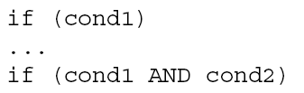
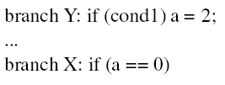
Global Branch Correlation (I)
Recently executed branch outcomes in the execution path are correlated with the outcome of the next branch
If first branch not taken, second also not taken
If first branch taken, second definitely not taken

Slide 48
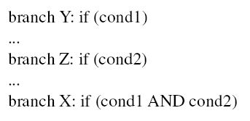
Global Branch Correlation (II)
If Y and Z both taken, then X also taken
If Y or Z not taken, then X also not taken

Slide 49
Global Branch Correlation (III)
Eqntott, SPEC’92: Generates truth table from Boolean expr.
  if (aa==2) ;; B1
  aa=0;
  if (bb==2) ;; B2
  bb=0;
  if (aa!=bb) { ;; B3
  ….
  }
  If B1 is not taken (i.e., aa==0@B3) and B2 is not taken (i.e. bb=0@B3) then B3 is certainly taken

Slide 50
Capturing Global Branch Correlation
Idea: Associate branch outcomes with “global T/NT history” of all branches
Make a prediction based on the outcome of the branch the last time the same global branch history was encountered
Implementation:
  Keep track of the “global T/NT history” of all branches in a register → Global History Register (GHR)
  Use GHR to index into a table that recorded the outcome that was seen for each GHR value in the recent past → Pattern History Table (table of 2-bit counters)
Global history/branch predictor
Uses two levels of history (GHR + history at that GHR)
Yeh and Patt, “Two-Level Adaptive Training Branch Prediction,” MICRO 1991.

Slide 51
Two Level Global Branch Prediction
First level: Global branch history register (N bits)
  The direction of last N branches
Second level: Table of saturating counters for each history entry
  The direction the branch took the last time the same history was seen
Pattern History Table (PHT)
00 …. 00
1 1 ….. 1 0
00 …. 01
2
3
GHR
(global history register)
previous
branch’s
direction
00 …. 10
index
0
1
11 …. 11
Yeh and Patt, “Two-Level Adaptive Training Branch Prediction,” MICRO 1991.

Slide 52
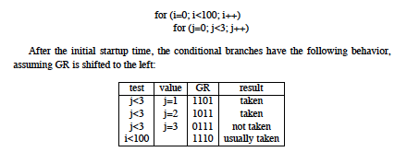
How Does the Global Predictor Work?
McFarling, “Combining Branch Predictors,” DEC WRL TR 1993.
This branch tests i
Last 4 branches test j
History: TTTN
Predict taken for i
Next history: TTNT
(shift in last outcome)
Notes:
Start with j=3, last iteration that is not taken…

Slide 53
Intel Pentium Pro Branch Predictor
Two level global branch predictor
4-bit global history register
Multiple pattern history tables (of 2 bit counters)
  Which pattern history table to use is determined by lower order bits of the branch address

Slide 54
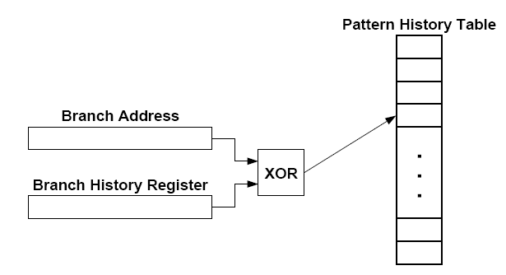
Improving Global Predictor Accuracy
Idea: Add more context information to the global predictor to take into account which branch is being predicted
  Gshare predictor: GHR hashed with the Branch PC
  + More context information used for prediction
  + Better utilization of the two-bit counter array
  -- Increases access latency
McFarling, “Combining Branch Predictors,” DEC WRL Tech Report, 1993.

Slide 55
Review: One-Level Branch Predictor
Direction predictor (2-bit counters)
taken?
PC + inst size
Next Fetch
Address
Program
Counter
hit?
Address of the
current instruction
target address
Cache of Target Addresses (BTB: Branch Target Buffer)

Slide 56
Two-Level Global History Branch Predictor
Which direction earlier
branches went
Direction predictor (2-bit counters)
taken?
Global branch
history
PC + inst size
Next Fetch
Address
Program
Counter
hit?
Address of the
current instruction
target address
Cache of Target Addresses (BTB: Branch Target Buffer)

Slide 57
Two-Level Gshare Branch Predictor
Which direction earlier
branches went
Direction predictor (2-bit counters)
taken?
Global branch
history
PC + inst size
Next Fetch
Address
XOR
Program
Counter
hit?
Address of the
current instruction
target address
Cache of Target Addresses (BTB: Branch Target Buffer)

Slide 58
Can We Do Better: Two-Level Prediction
Last-time and 2BC predictors exploit only “last-time” predictability for a given branch
Realization 1: A branch’s outcome can be correlated with other branches’ outcomes
  Global branch correlation
Realization 2: A branch’s outcome can be correlated with past outcomes of the same branch (in addition to the outcome of the branch “last-time” it was executed)
  Local branch correlation
Yeh and Patt, “Two-Level Adaptive Training Branch Prediction,” MICRO 1991.

Slide 59
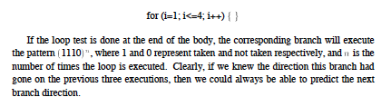
Local Branch Correlation
McFarling, “Combining Branch Predictors,” DEC WRL TR 1993.

Slide 60
More Motivation for Local History
To predict a loop branch “perfectly”, we want to identify the last iteration of the loop
By having a separate PHT entry for each local history, we can distinguish different iterations of a loop
Works for “short” loops

Slide 61
Capturing Local Branch Correlation
Idea: Have a per-branch history register
  Associate the predicted outcome of a branch with “T/NT history” of the same branch
Make a prediction based on the outcome of the branch the last time the same local branch history was encountered
Called the local history/branch predictor
Uses two levels of history (Per-branch history register + history at that history register value)

Slide 62
Two Level Local Branch Prediction
First level: A set of local history registers (N bits each)
  Select the history register based on the PC of the branch
Second level: Table of saturating counters for each history entry
  The direction the branch took the last time the same history was seen
Pattern History Table (PHT)
00 …. 00
1 1 ….. 1 0
00 …. 01
2
3
00 …. 10
index
0
1
Local history registers
11 …. 11
Yeh and Patt, “Two-Level Adaptive Training Branch Prediction,” MICRO 1991.

Slide 63
Two-Level Local History Branch Predictor
Which directions earlier instances of *this branch* went
Direction predictor (2-bit counters)
taken?
PC + inst size
Next Fetch
Address
Program
Counter
hit?
Address of the
current instruction
target address
Cache of Target Addresses (BTB: Branch Target Buffer)

Slide 64
Can We Do Even Better?
Predictability of branches varies
Some branches are more predictable using local history
Some using global
For others, a simple two-bit counter is enough
Yet for others, a single bit is enough
Observation: There is heterogeneity in predictability behavior of branches
  No one-size fits all branch prediction algorithm for all branches
Idea: Exploit that heterogeneity by designing heterogeneous branch predictors

Slide 65
Hybrid Branch Predictors
Idea: Use more than one type of predictor (i.e., multiple algorithms) and select the “best” prediction
  E.g., hybrid of 2-bit counters and global predictor
Advantages:
+ Better accuracy: different predictors are better for different branches
+ Reduced warmup time (faster-warmup predictor used until the slower-warmup predictor warms up)
Disadvantages:
-- Need “meta-predictor” or “selector”
-- Longer access latency
  McFarling, “Combining Branch Predictors,” DEC WRL Tech Report, 1993.

Slide 66
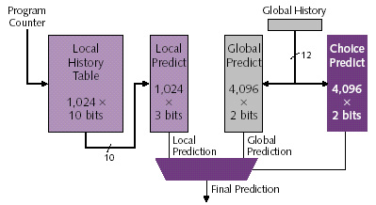
Alpha 21264 Tournament Predictor
Minimum branch penalty: 7 cycles
Typical branch penalty: 11+ cycles
48K bits of target addresses stored in I-cache
Predictor tables are reset on a context switch
Kessler, “The Alpha 21264 Microprocessor,” IEEE Micro 1999.

Slide 67
Are We Done w/ Branch Prediction?
Hybrid branch predictors work well
  E.g., 90-97% prediction accuracy on average
Some “difficult” workloads still suffer, though!
  E.g., gcc
  Max IPC with tournament prediction: 9
  Max IPC with perfect prediction: 35

Slide 68
Some Other Branch Predictor Types
Loop branch detector and predictor
  Loop iteration count detector/predictor
  Works well for loops with small number of iterations, where iteration count is predictable
  Used in Intel Pentium M
Perceptron branch predictor
  Learns the direction correlations between individual branches
  Assigns weights to correlations
  Jimenez and Lin, “Dynamic Branch Prediction with Perceptrons,” HPCA 2001.
Hybrid history length based predictor
  Uses different tables with different history lengths
  Seznec, “Analysis of the O-Geometric History Length branch predictor,” ISCA 2005.

Slide 69
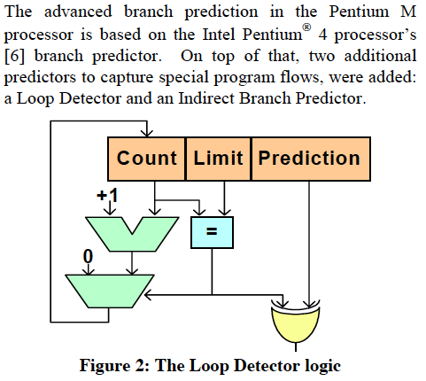
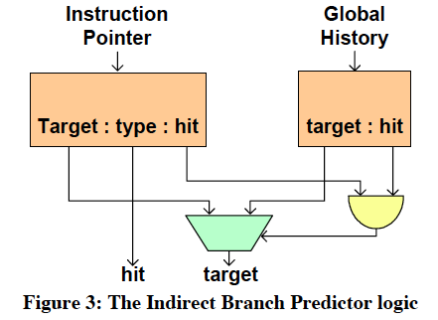
Intel Pentium M Predictors
Gochman et al.,
“The Intel Pentium M Processor: Microarchitecture and Performance,”
Intel Technology Journal, May 2003.

Slide 70
Perceptrons for Learning Linear Functions
A perceptron is a simplified model of a biological neuron
It is also a simple binary classifier
A perceptron maps an input vector X to a 0 or 1
  Input = Vector X
  Perceptron learns the linear function (if one exists) of how each element of the vector affects the output (stored in an internal Weight vector)
  Output = Weight.X + Bias > 0
In the branch prediction context
  Vector X: Branch history register bits
  Output: Prediction for the current branch

Slide 71
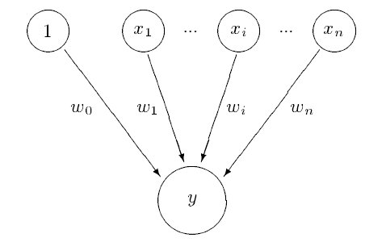
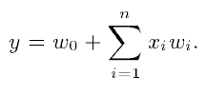
Perceptron Branch Predictor (I)
Idea: Use a perceptron to learn the correlations between branch history register bits and branch outcome
A perceptron learns a target Boolean function of N inputs
  Jimenez and Lin, “Dynamic Branch Prediction with Perceptrons,” HPCA 2001.
  Rosenblatt, “Principles of Neurodynamics: Perceptrons and the Theory of Brain Mechanisms,” 1962
Each branch associated with a perceptron
A perceptron contains a set of weights wi
Each weight corresponds to a bit in
the GHR
How much the bit is correlated with the
direction of the branch
→ Positive correlation: large + weight
→ Negative correlation: large - weight
Prediction:
→ Express GHR bits as 1 (T) and -1 (NT)
→ Take dot product of GHR and weights
→ If output > 0, predict taken

Slide 72
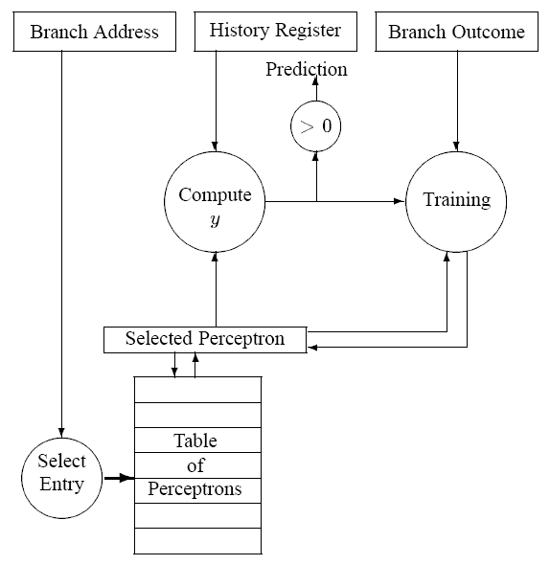
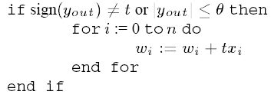
Perceptron Branch Predictor (II)
Prediction function:
Dot product of GHR
and perceptron weights
Output
compared
to 0
Bias weight
(bias of branch, independent of
the history)
Training function:

Slide 73
Perceptron Branch Predictor (III)
Advantages
  + More sophisticated learning mechanism → better accuracy
Disadvantages
  -- Hard to implement (adder tree to compute perceptron output)
  -- Can learn only linearly-separable functions
  e.g., cannot learn XOR type of correlation between 2 history bits and branch outcome

Slide 74
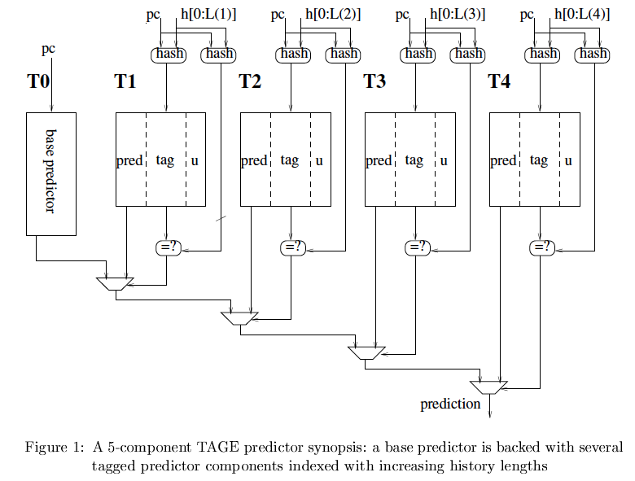
Prediction Using Multiple History Lengths
Observation: Different branches require different history lengths for better prediction accuracy
Idea: Have multiple PHTs indexed with GHRs with different history lengths and intelligently allocate PHT entries to different branches
Seznec and Michaud, “A case for (partially) tagged Geometric History Length
Branch Prediction,” JILP 2006.

Slide 75
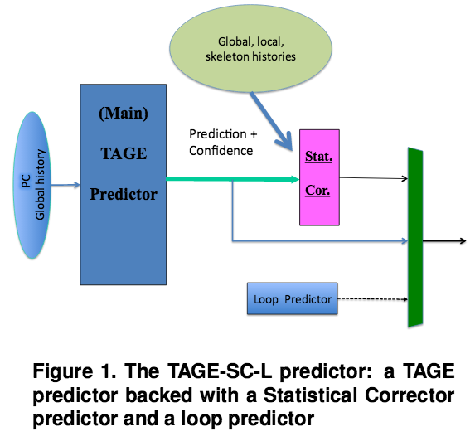
State of the Art in Branch Prediction
See the Branch Prediction Championship
  https://www.jilp.org/cbp2016/program.html
Andre Seznec,
“TAGE-SC-L branch predictors,”
CBP 2014.
Andre Seznec,
“TAGE-SC-L branch predictors
again,” CBP 2016.

Slide 76
Branch Confidence Estimation
Idea: Estimate if the prediction is likely to be correct
  i.e., estimate how “confident” you are in the prediction
Why?
  Could be very useful in deciding how to speculate:
    What predictor/PHT to choose/use
    Whether to keep fetching on this path
    Whether to switch to some other way of handling the branch, e.g. dual-path execution (eager execution) or dynamic predication
    …
Jacobsen et al., “Assigning Confidence to Conditional Branch Predictions,” MICRO 1996.

Slide 77
Other Ways of Handling Branches

Slide 78
How to Handle Control Dependences
Critical to keep the pipeline full with correct sequence of dynamic instructions.
Potential solutions if the instruction is a control-flow instruction:
Stall the pipeline until we know the next fetch address
Guess the next fetch address (branch prediction)
Employ delayed branching (branch delay slot)
Do something else (fine-grained multithreading)
Eliminate control-flow instructions (predicated execution)
Fetch from both possible paths (if you know the addresses of both possible paths) (multipath execution)

Slide 79
Delayed Branching (I)
Change the semantics of a branch instruction
  Branch after N instructions
  Branch after N cycles
Idea: Delay the execution of a branch. N instructions (delay slots) that come after the branch are always executed regardless of branch direction.
Problem: How do you find instructions to fill the delay slots?
  Branch must be independent of delay slot instructions
Unconditional branch: Easier to find instructions to fill the delay slot
Conditional branch: Condition computation should not depend on instructions in delay slots → difficult to fill the delay slot

Slide 80
Delayed Branching (II)
Normal code:
Timeline:
Delayed branch code:
Timeline:
A
if
ex
A
if
ex
B
C
C
A
BC X
A
BC X
B
A
B
C
A
D
C
B
D
BC
C
E
BC
C
E
B
BC
F
--
BC
F
G
B
X:
G
G
--
X:
G
6 cycles
5 cycles

Slide 81
Fancy Delayed Branching (III)
Delayed branch with squashing
  In SPARC
  Semantics: If the branch falls through (i.e., it is not taken), the delay slot instruction is not executed
  Why could this help?
Normal code:
Delayed branch code:
Delayed branch w/ squashing:
X:
A
X:
A
A
B
B
X:
B
C
C
C
BC X
BC X
BC X
D
NOP
A
E
D
D
E
E

Slide 82
Delayed Branching (IV)
Advantages:
+ Keeps the pipeline full with useful instructions in a simple way assuming
1. Number of delay slots == number of instructions to keep the pipeline full before the branch resolves
2. All delay slots can be filled with useful instructions
Disadvantages:
  -- Not easy to fill the delay slots (even with a 2-stage pipeline)
  1. Number of delay slots increases with pipeline depth, superscalar execution width
  2. Number of delay slots should be variable with variable latency operations. Why?
-- Ties ISA semantics to hardware implementation
-- SPARC, MIPS, HP-PA: 1 delay slot
-- What if pipeline implementation changes with the next design?

Slide 83
An Aside: Filling the Delay Slot
reordering data
independent
(RAW, WAW,
WAR)
instructions
does not change
program semantics
Safe?
within same
basic block
For correctness:
add a new instruction
to the not-taken path?
For correctness:
add a new instruction
to the taken path?
[Based on original figure from P&H CO&D, COPYRIGHT 2004 Elsevier. ALL RIGHTS RESERVED.]

Slide 84
How to Handle Control Dependences
Critical to keep the pipeline full with correct sequence of dynamic instructions.
Potential solutions if the instruction is a control-flow instruction:
Stall the pipeline until we know the next fetch address
Guess the next fetch address (branch prediction)
Employ delayed branching (branch delay slot)
Do something else (fine-grained multithreading)
Eliminate control-flow instructions (predicated execution)
Fetch from both possible paths (if you know the addresses of both possible paths) (multipath execution)

Slide 85
Predicate Combining (not Predicated Execution)
Complex predicates are converted into multiple branches
  if ((a == b) && (c < d) && (a > 5000)) { … }
    3 conditional branches
Problem: This increases the number of control dependencies
Idea: Combine predicate operations to feed a single branch instruction instead of having one branch for each
  Predicates stored and operated on using condition registers
  A single branch checks the value of the combined predicate
+ Fewer branches in code → fewer mipredictions/stalls
-- Possibly unnecessary work
-- If the first predicate is false, no need to compute other predicates
Condition registers exist in IBM RS6000 and the POWER architecture

Slide 86
Predication (Predicated Execution)
Idea: Convert control dependence to data dependence
Simple example: Suppose we had a Conditional Move instruction…
  CMOV condition, R1 ← R2
  R1 = (condition == true) ? R2 : R1
  Employed in most modern ISAs (x86, Alpha)
Code example with branches vs. CMOVs
  if (a == 5) {b = 4;} else {b = 3;}
  CMPEQ condition, a, 5;
  CMOV condition, b ← 4;
  CMOV !condition, b ← 3;

Slide 87
Predication (Predicated Execution)
Idea: Compiler converts control dependence into data dependence → branch is eliminated
  Each instruction has a predicate bit set based on the predicate computation
  Only instructions with TRUE predicates are committed (others turned into NOPs)
(normal branch code)
(predicated code)
A
T
N
A
if (cond) {
b = 0;
}
else {
b = 1;
}
C
B
B
C
D
D
A
p1 = (cond)
branch p1, TARGET
A
p1 = (cond)
(!p1) mov b, 1
(p1) mov b, 0
B
B
mov b, 1
jmp JOIN
C
C
TARGET:
mov b, 0
D
add x, b, 1
D
add x, b, 1

Slide 88
Predicated Execution References
Allen et al., “Conversion of control dependence to data dependence,” POPL 1983.
Kim et al., “Wish Branches: Combining Conditional Branching and Predication for Adaptive Predicated Execution,” MICRO 2005.

Slide 89
Conditional Move Operations
Very limited form of predicated execution
CMOV R1 ← R2
  R1 = (ConditionCode == true) ? R2 : R1
  Employed in most modern ISAs (x86, Alpha)

Slide 90
Predicated Execution (II)
Predicated execution can be high performance and energy-efficient
Predicated Execution
A
Fetch Decode Rename Schedule RegisterRead Execute
C
B
F
E
E
F
D
F
D
E
F
C
A
B
A
E
F
C
D
B
F
D
E
B
C
A
F
E
C
D
A
B
E
D
B
C
A
D
C
A
B
C
B
A
B
A
E
A
A
F
D
E
F
C
D
E
B
C
D
A
B
A
C
D
A
B
B
A
C
C
B
nop
Branch Prediction
D
Fetch Decode Rename Schedule RegisterRead Execute
F
E
D
B
A
E
Pipeline flush!!
F

Slide 91
Predicated Execution
Eliminates branches → enables straight line code (i.e., larger basic blocks in code)
Advantages
  Eliminates hard-to-predict branches
  Always-not-taken prediction works better (no branches)
  Compiler has more freedom to optimize code (no branches)
    control flow does not hinder inst. reordering optimizations
    code optimizations hindered only by data dependencies
Disadvantages
  Useless work: some instructions fetched/executed but discarded (especially bad for easy-to-predict branches)
  Requires additional ISA (and hardware) support
  Can we eliminate all branches this way?

Slide 92
Predicated Execution vs. Branch Prediction
+ Eliminates mispredictions for hard-to-predict branches
+ No need for branch prediction for some branches
+ Good if misprediction cost > useless work due to predication
-- Causes useless work for branches that are easy to predict
-- Reduces performance if misprediction cost < useless work
-- Adaptivity: Static predication is not adaptive to run-time branch behavior. Branch behavior changes based on input set, program phase, control-flow path.

Slide 93
Predicated Execution in Intel Itanium
Each instruction can be separately predicated
64 one-bit predicate registers
each instruction carries a 6-bit predicate field
An instruction is effectively a NOP if its predicate is false
cmp
p1 p2 ←cmp
br
p2
else1
else1
p1
then1
join1
else2
p1
then2
br
p2
else2
then1
join2
then2
join1
join2

Slide 94
Conditional Execution in the ARM ISA
Almost all ARM instructions can include an optional condition code.
  Prior to ARM v8
An instruction with a condition code is executed only if the condition code flags in the CPSR meet the specified condition.

Slide 95
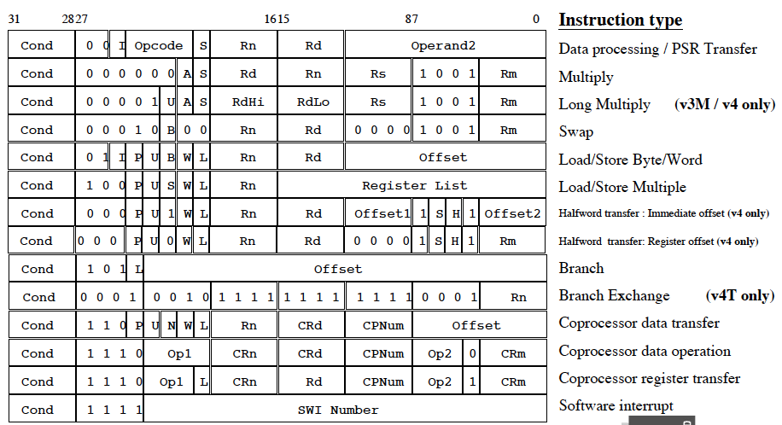
Conditional Execution in ARM ISA

Slide 96
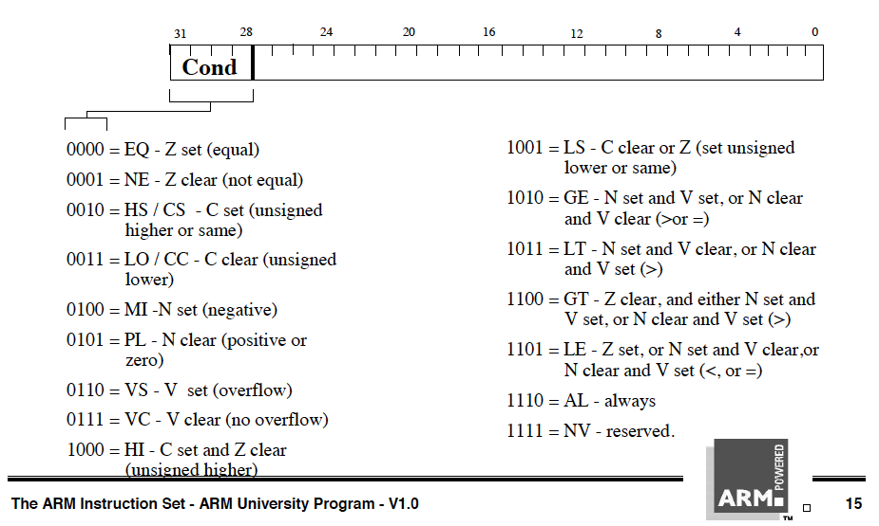
Conditional Execution in ARM ISA

Slide 97
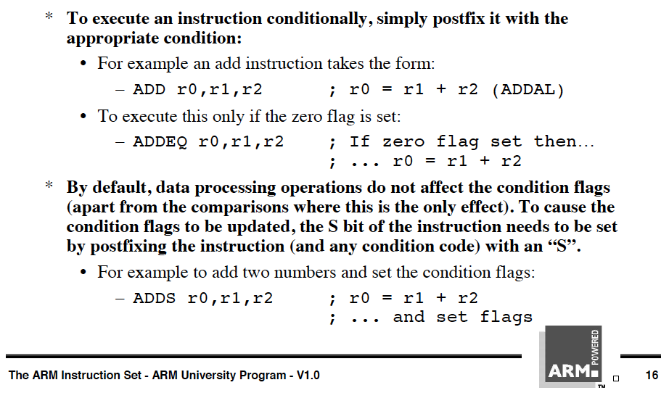
Conditional Execution in ARM ISA

Slide 98
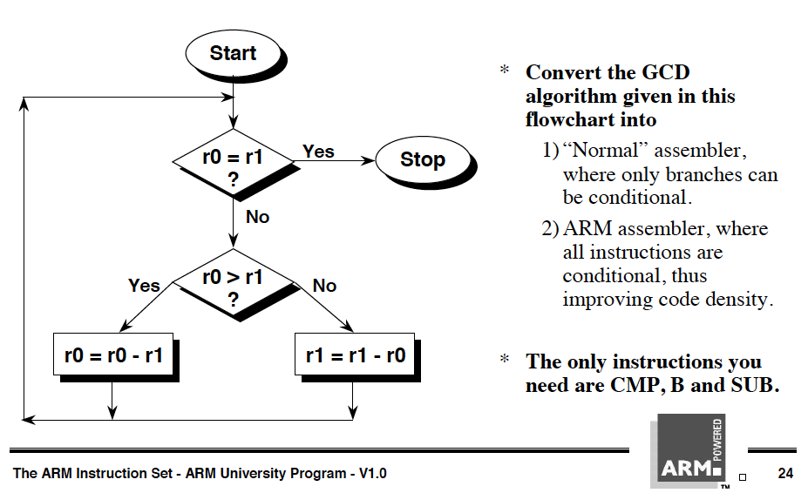
Conditional Execution in ARM ISA

Slide 99
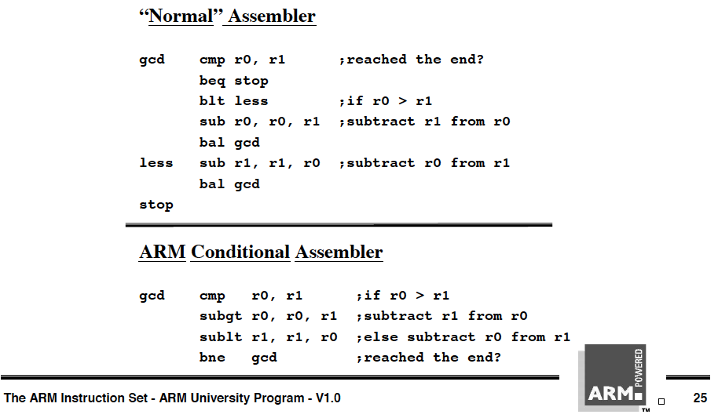
Conditional Execution in ARM ISA

Slide 100
How to Handle Control Dependences
Critical to keep the pipeline full with correct sequence of dynamic instructions.
Potential solutions if the instruction is a control-flow instruction:
Stall the pipeline until we know the next fetch address
Guess the next fetch address (branch prediction)
Employ delayed branching (branch delay slot)
Do something else (fine-grained multithreading)
Eliminate control-flow instructions (predicated execution)
Fetch from both possible paths (if you know the addresses of both possible paths) (multipath execution)

Slide 101
Multi-Path Execution
Idea: Execute both paths after a conditional branch
  For all branches: Riseman and Foster, “The inhibition of potential parallelism by conditional jumps,” IEEE Transactions on Computers, 1972.
  For a hard-to-predict branch: Use dynamic confidence estimation
Advantages:
  + Improves performance if misprediction cost > useless work
  + No ISA change needed
Disadvantages:
  -- What happens when the machine encounters another hard-to-predict branch? Execute both paths again?
  -- Paths followed quickly become exponential
  -- Each followed path requires its own context (registers, PC, GHR)
  -- Wasted work (and reduced performance) if paths merge

Slide 102
Dual-Path Execution versus Predication
Dual-path
Predicated Execution
A
Hard to predict
path 1
path 2
path 1
path 2
C
B
C
B
C
B
D
D
D
CFMerge
CFMerge
D
E
E
E
E
F
F
F
F

Slide 103
Handling Other Types of Branches

Slide 104
Remember: Branch Types
Type | Direction at fetch time | Number of possible next fetch addresses? | When is next fetch address resolved?
Conditional | Unknown | 2 | Execution (register dependent)
Unconditional | Always taken | 1 | Decode (PC + offset)
Call | Always taken | 1 | Decode (PC + offset)
Return | Always taken | Many | Execution (register dependent)
Indirect | Always taken | Many | Execution (register dependent)
How can we predict an indirect branch with many target addresses?

Slide 105
Call and Return Prediction
Call X
…
  Call X
  …
    Call X
    …
    Return
  Return
Return
Direct calls are easy to predict
  Always taken, single target
  Call marked in BTB, target predicted by BTB
Returns are indirect branches
  A function can be called from many points in code
  A return instruction can have many target addresses
    Next instruction after each call point for the same function
  Observation: Usually a return matches a call
  Idea: Use a stack to predict return addresses (Return Address Stack)
    A fetched call: pushes the return (next instruction) address on the stack
    A fetched return: pops the stack and uses the address as its predicted target
    Accurate most of the time: 8-entry stack → > 95% accuracy

Slide 106
Indirect Branch Prediction (I)
Register-indirect branches have multiple targets
Used to implement
  Switch-case statements
  Virtual function calls
  Jump tables (of function pointers)
  Interface calls
A
A
R1 = MEM[R2]
branch R1
N
br.cond TARGET
T
?
TARG
A+1
α
β
δ
ρ
Conditional (Direct) Branch
Indirect Jump

Slide 107
Indirect Branch Prediction (II)
No direction prediction needed
Idea 1: Predict the last resolved target as the next fetch address
  + Simple: Use the BTB to store the target address
  -- Inaccurate: 50% accuracy (empirical). Many indirect branches switch between different targets
Idea 2: Use history based target prediction
  E.g., Index the BTB with GHR XORed with Indirect Branch PC
  Chang et al., “Target Prediction for Indirect Jumps,” ISCA 1997.
  + More accurate
  -- An indirect branch maps to (too) many entries in BTB
  -- Conflict misses with other branches (direct or indirect)
  -- Inefficient use of space if branch has few target addresses

Slide 108
Intel Pentium M Indirect Branch Predictor
Gochman et al.,
“The Intel Pentium M Processor: Microarchitecture and Performance,”
Intel Technology Journal, May 2003.

Slide 109
Issues in Branch Prediction (I)
Need to identify a branch before it is fetched
How do we do this?
  BTB hit → indicates that the fetched instruction is a branch
  BTB entry contains the “type” of the branch
  Pre-decoded “branch type” information stored in the instruction cache identifies type of branch
What if no BTB?
  Bubble in the pipeline until target address is computed
  E.g., IBM POWER4

Slide 110
Latency of Branch Prediction
Latency: Prediction is latency critical
  Need to generate next fetch address for the next cycle
  Bigger, more complex predictors are more accurate but slower
PC + inst size
BTB target
Next Fetch
Address
Return Address Stack target
Indirect Branch Predictor target
Resolved target from Backend
???

